Slide 1
Lecture 8 Sampling Distributions, margin of error, Types of studies

Slide 2
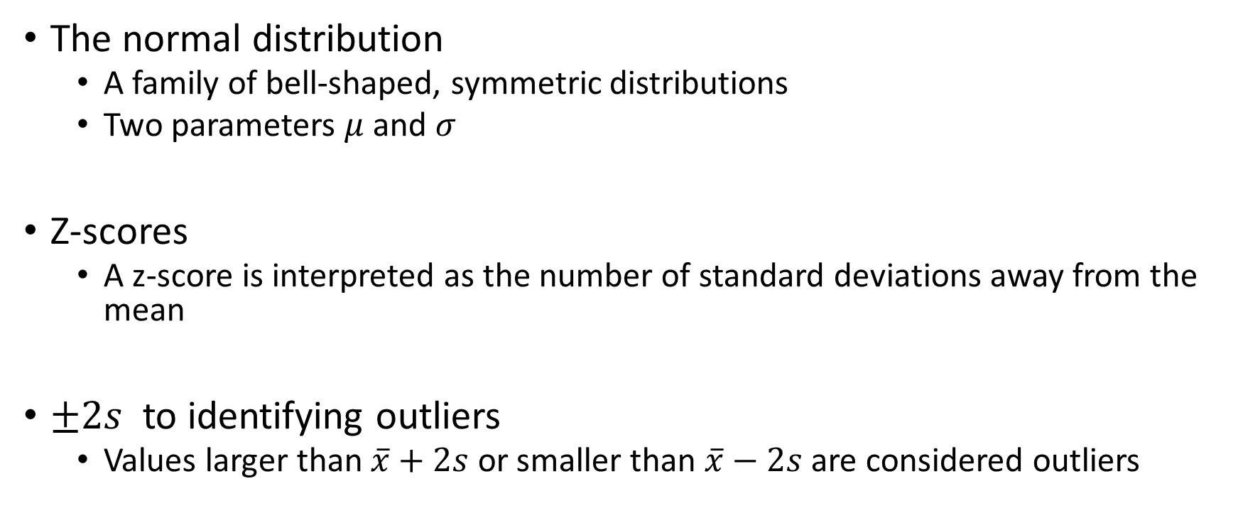
Review From Monday 2/5
The normal distribution
A family of bell-shaped, symmetric distributions
Two parameters $μ$ and $σ$
Z-scores
A z-score is interpreted as the number of standard deviations away from the mean
$±2s$ to identifying outliers
Values larger than $\overline{x}+2s$ or smaller than $\overline{x}−2s$ are considered outliers

Slide 3
Practice: Time Spent Playing Defense in Rocket League

